Slide 1

DATA ANALYTICS - STA 6714
University of central Florida
LEELA SRAVANTHI CHIGURUPATI

Slide 2
Introduction to the Dataset
The Data set is derived from World Health Organization(WHO)
Why this dataset?
This dataset provides Life expectancy ages of various countries from the year 2000 to 2015. The data set consists of various variables like Population, income, BMI, expenditure and shows various behaviors which might affect life expectancy like diseases and diet.
Data Source: https://www.who.int/data/gho/data/themes/topics/indicator-groups/indicator-group-details/GHO/life-expectancy-and-healthy-life-expectancy
https://www.kaggle.com/kumarajarshi/life-expectancy-who

Slide 3
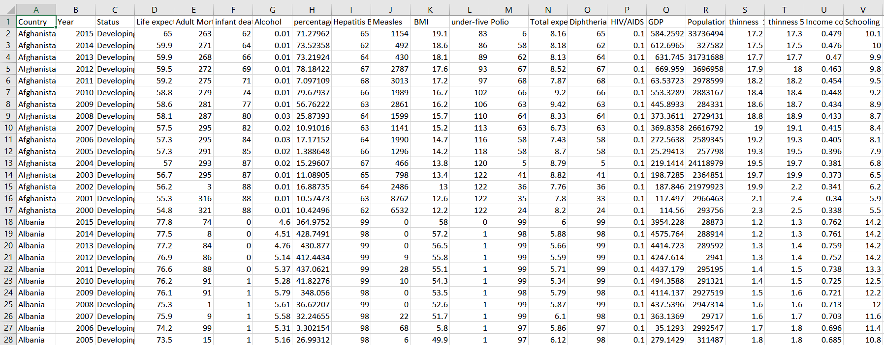
Here is a snapshot of the Dataset

Slide 4
Motive:
“The goal of this project is to find out any potential relationships or influences of various variables like population, income, GDP on the LIFE EXPECTANCY of various countries.”

Slide 5
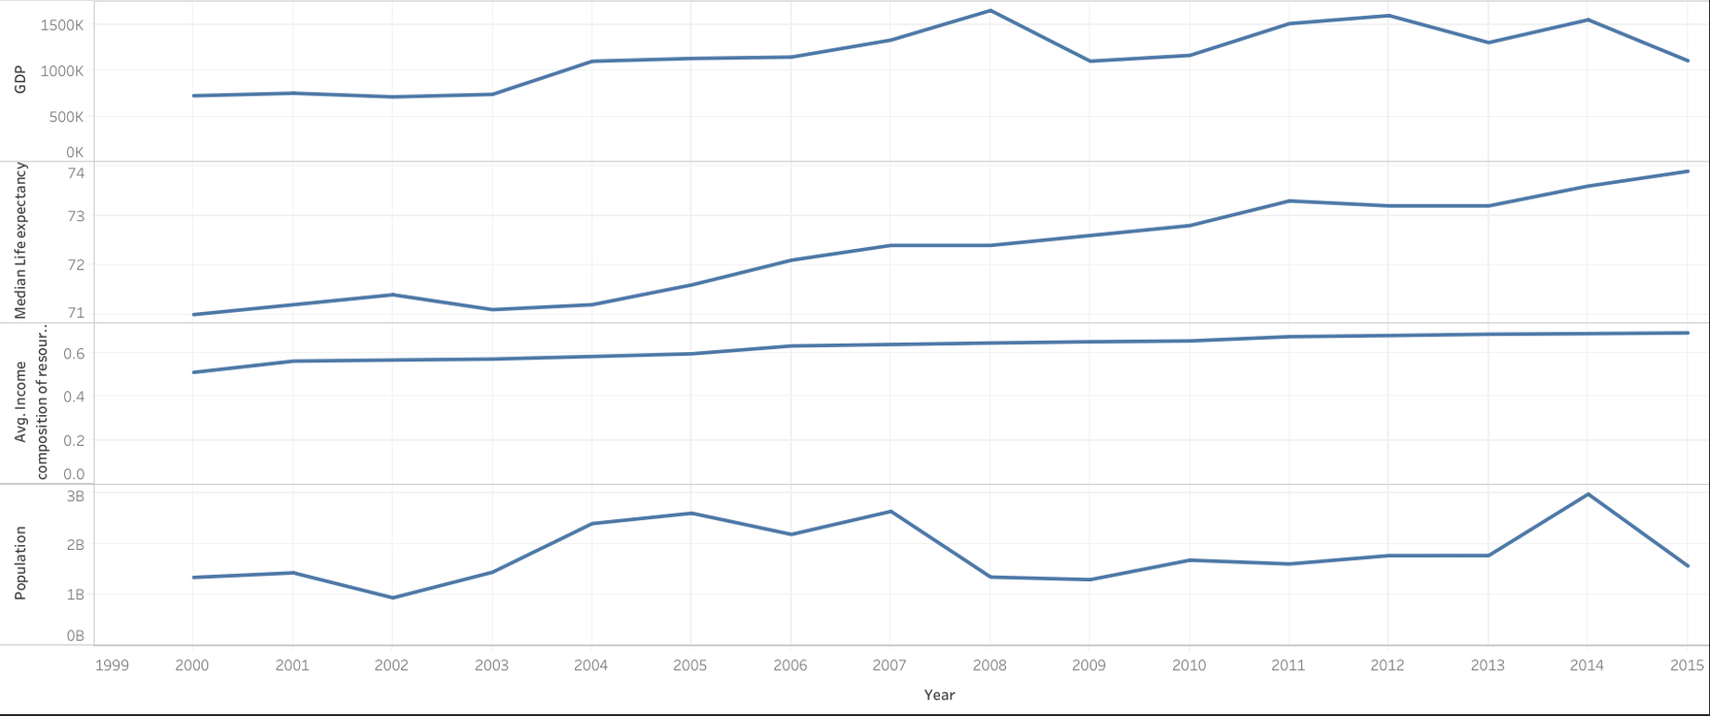
GDP, Life Expectancy, income, Population over the years 2000 to 2015

Slide 6
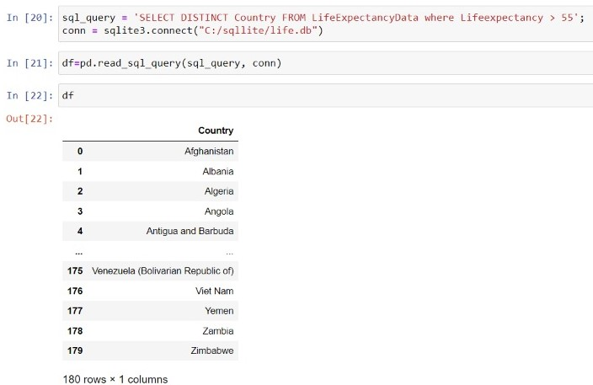
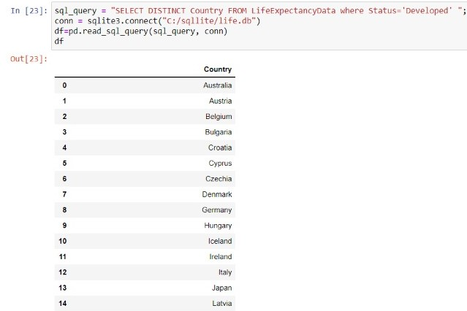
SQLite
Using SQLite, I imported the dataset into the database and ran various SQL commands to test the data and investigate it.
Here are a few examples of what I did.

Slide 7


Python
Before entering the regression model, I played around with the data using python to conduct correlation test on Life expectancy with population and schooling to check if there is any trend to observe.
After conducting Pearson correlation test between Life Expectancy, a positive correlation is observed and similarly Life Expectancy and Schooling also show positive correlation.

Slide 8
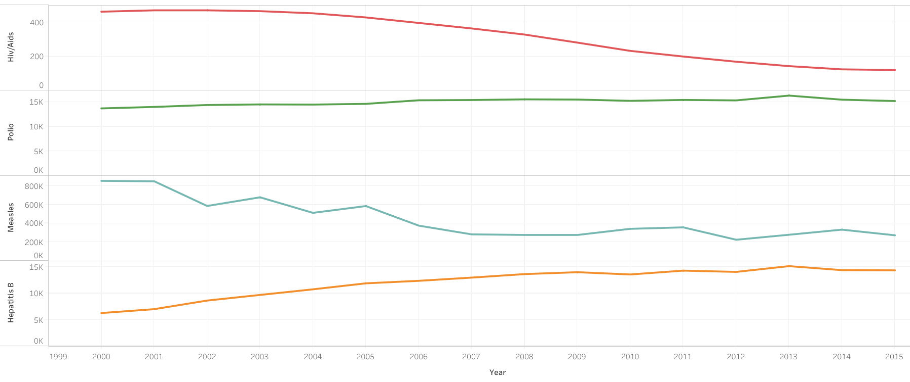
Line Graph depicting various diseases over years 2000 to 2015

Slide 9
Multiple Linear Regression
For this project, we have various variables to work with such Life Expectancy (Dependent variable) and many more like income, schooling, mortality, population (independent variables)
In this scenario, we will predict dependent variable Life Expectancy using multiple independent variables such as population, mortality, schooling and to establish relationship between the independent and dependent variables.
Using R studio, I carried out MLR Statistical technique.

Slide 10
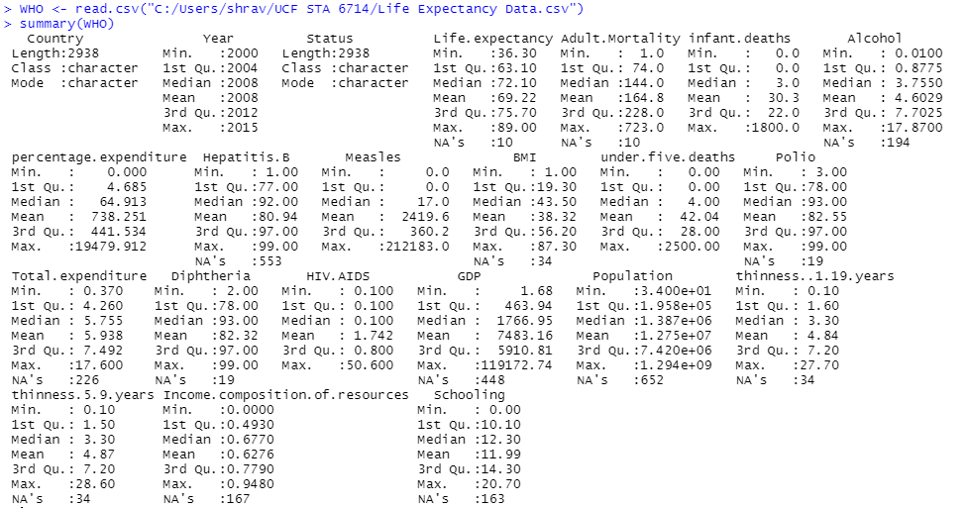
Summary data

Slide 11
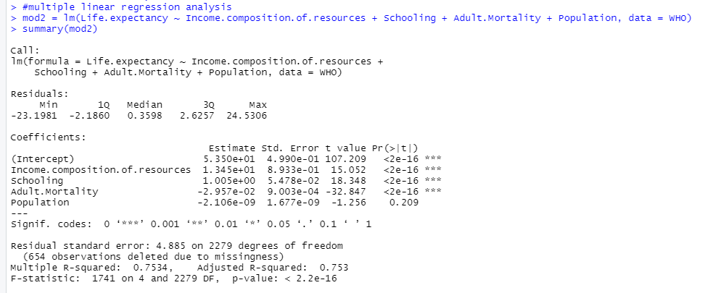
Multiple Linear Regression
Here are the results of MLR with Life Expectancy(Predictor) and income, school, mortality, population(response).
Notes:
Residuals – pred – actual
Division bet estimates/stderror is t
Multiple R – correlation coeff – measures strength of linear relationship
1 – perfect linear relationship 0 – none. 0.75 is fairly strong LR.
R square - coeff of determination – how much % of input(proportion of variance) can be explained by target variable.
0.75 – 75% of the variance in target can be explained by input.
Adjusted R square – always lower than R square. Used to compare fit of regression models.
Adj for mlr coz it scales multiple parameters, single – not needed so we use multiple r
Less f stat , the better, it should always show

Slide 12
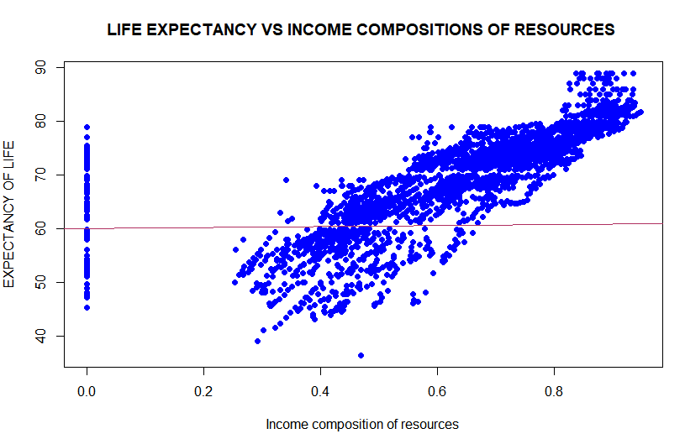
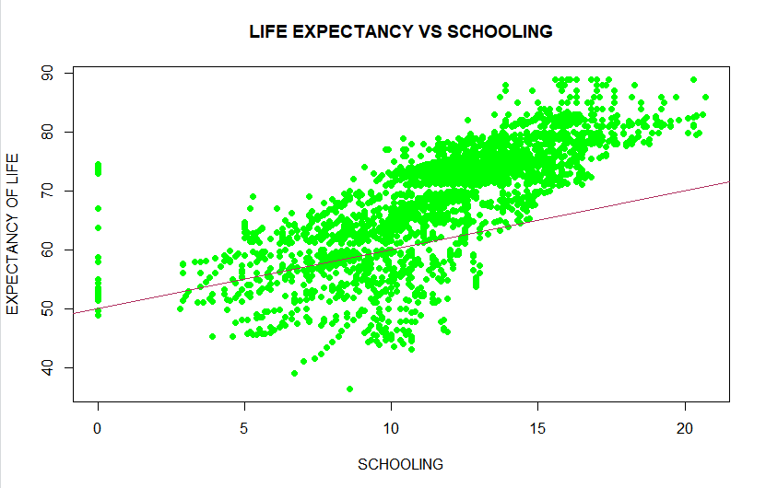
Plots for Life Expectancy VS income & Schooling with regression line.

Slide 13
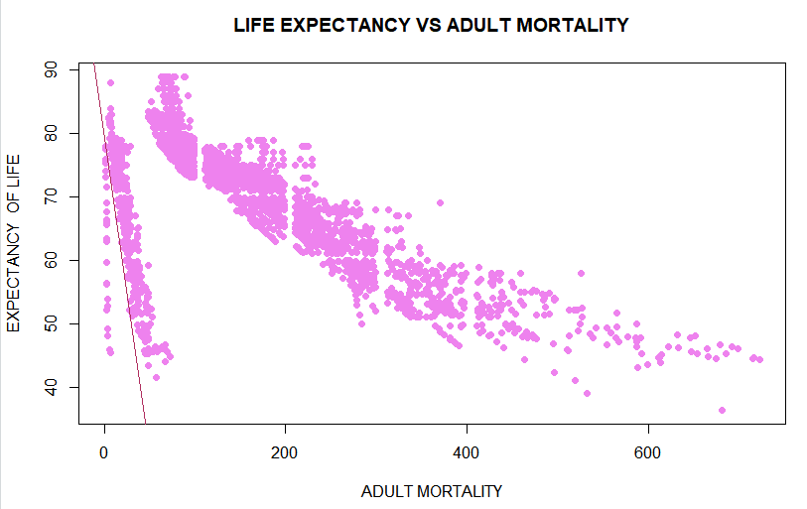
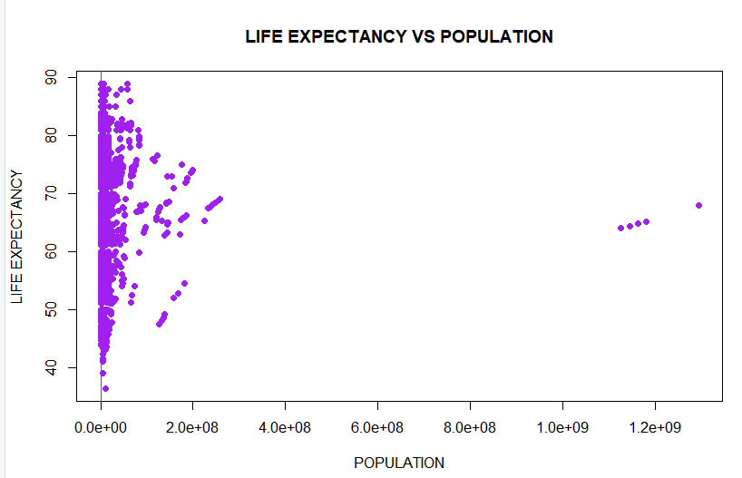
Plots for Life Expectancy VS income & Schooling with regression line.

Slide 14
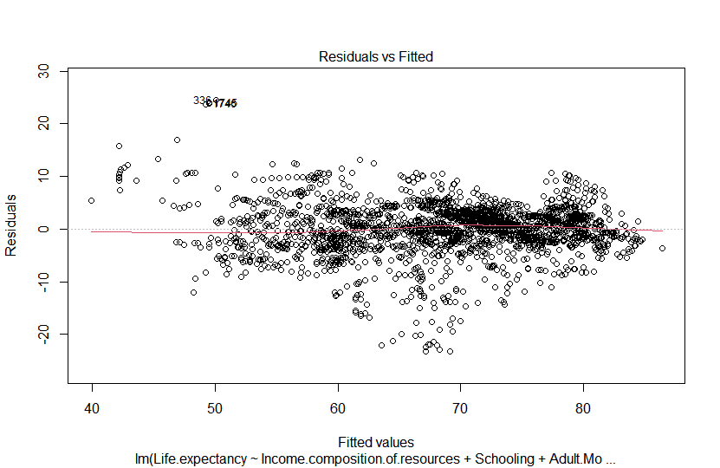
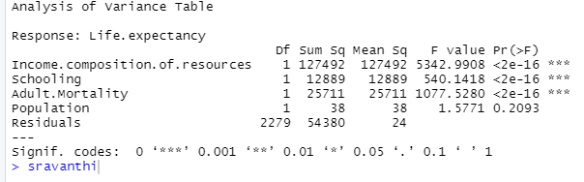
Residuals VS Fitted and ANOVA
On conducting analysis of variances, the results of Probability stand on point with our previous results.

Slide 15
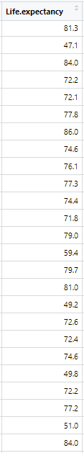

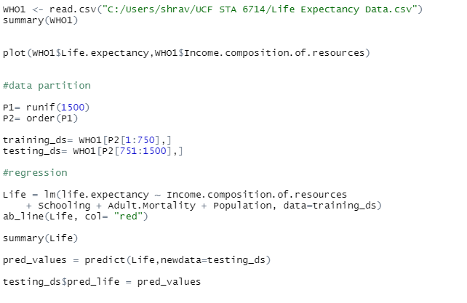
Original Life Expectancy VS Predicated Life Expectancy
Here, I used training and testing set using MLR to predict life expectancy values with R Square about 0.75

Slide 16
Conclusion
In this project, we played around with Life Expectancy Data from WHO with various statistical tools like R, Python, SQLite.
Using Python and SQLite, I took a deep dive into dataset conducting tests like Pearson’s correlation.
Multiple Linear Regression is carried out with Life Expectancy and 4 dependent variables showing relationship and influence between them using summary and scatter plots.
We predicted Life Expectancy values from the 4 independent values with R square 0.75 or 75% accuracy and P value of 2.2e-16 which is in favor of alternate hypothesis.

Slide 17

THE END
ANY QUERIES?

